Slide 1

Towns with healthy lifestyle
Isha Sodhi

Slide 2
Background & problem
Real estate market is observing new demand from their customers due to the current pandemic situation
Demand is to have a home in a town that provides options for healthy lifestyle
People want easy access to Parks, playgrounds and farmers’ market
Real estate agents need the help of Data science for their rescue

Slide 3
data
Raw data source: Wikipedia
Data wrangling using Pandas
Data source for Venue categories: Foursquare

Slide 4
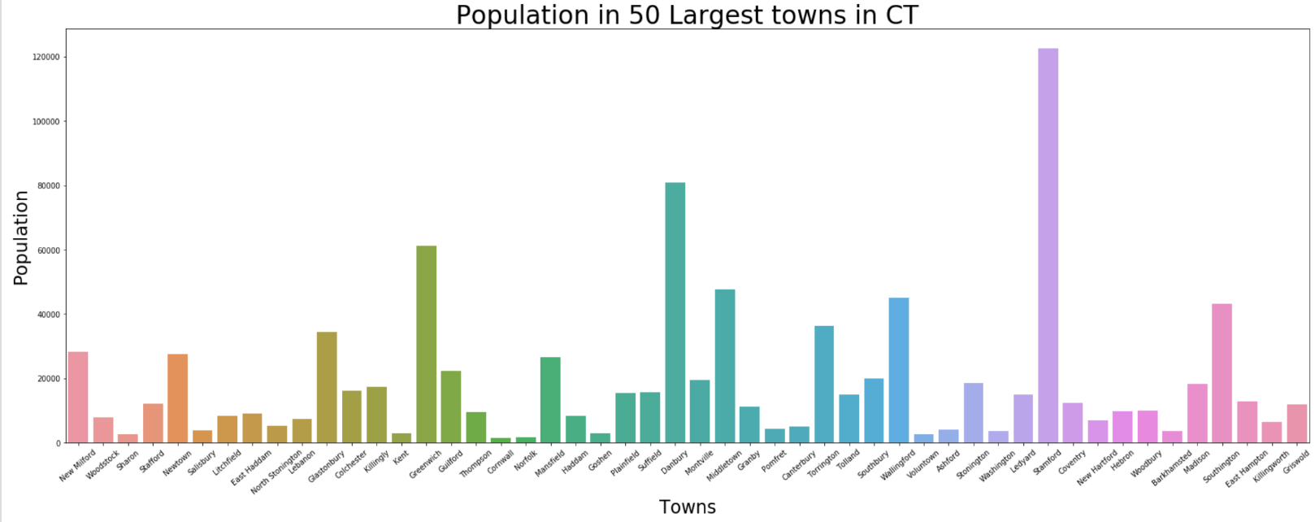
methodology
Analysis::
Stamford- most populated

Slide 5
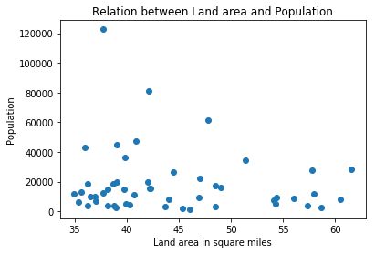
Analysis::
No particular relation between land area and population

Slide 6
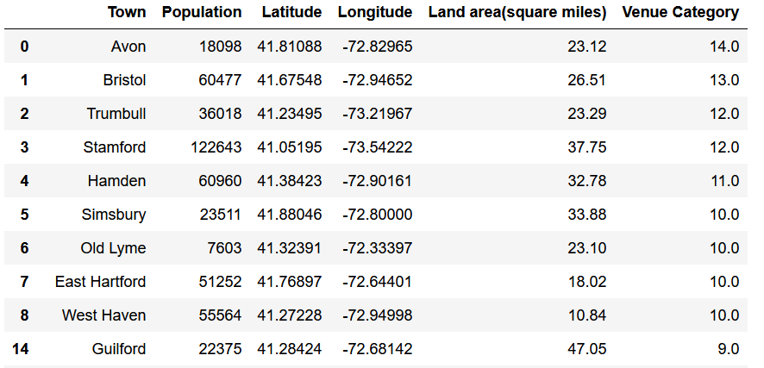
Analysis::
Top 10 towns with most venue categories of interest

Slide 7
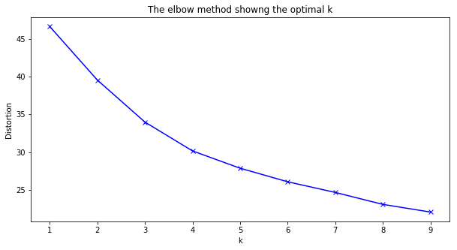
Analysis::
Finding ‘k’ using elbow method

Slide 8
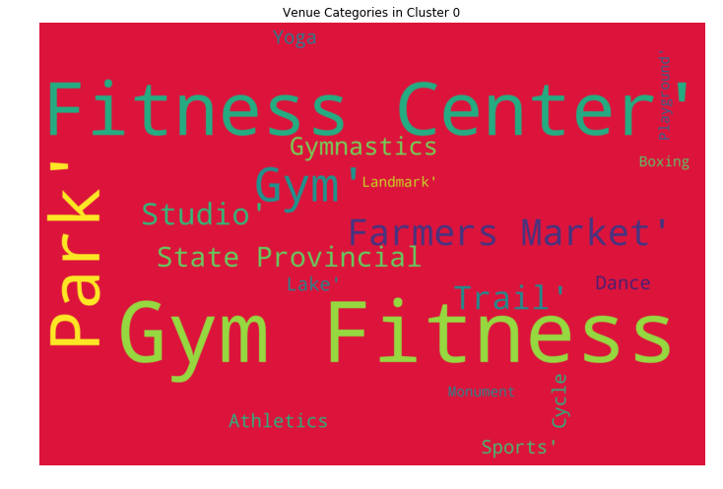
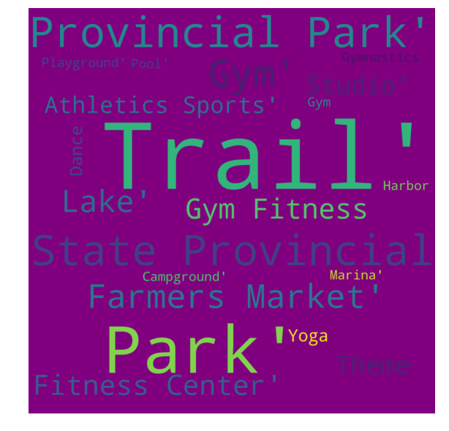
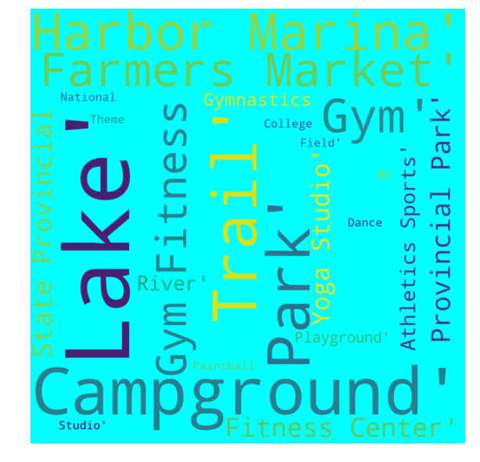
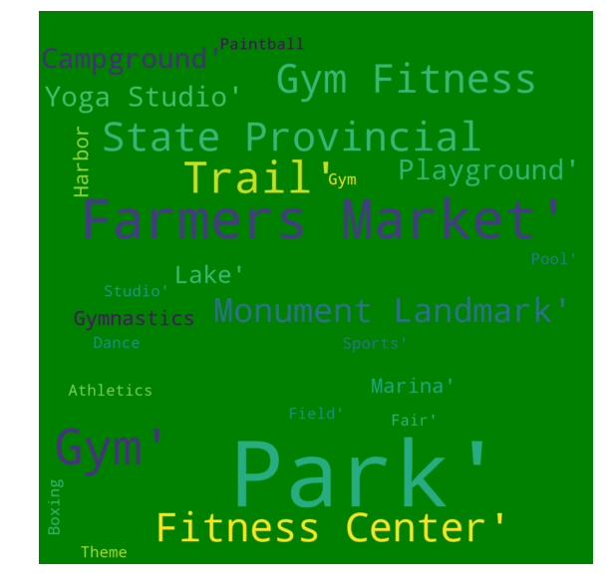
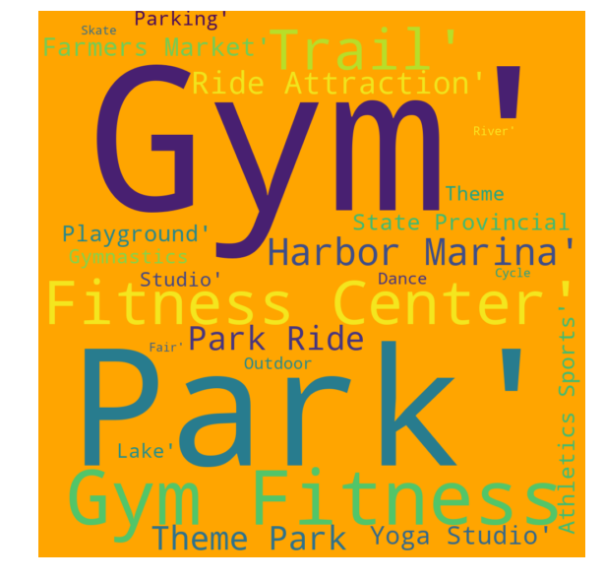
results
Cluster0
Cluster1
Cluster2
Cluster3
Cluster4

Slide 9
conclusion
According to me, any person looking for healthy lifestyle options should choose a town from cluster4 as it has almost all the venue categories.

